Slide 1
develoPING A Marketing Strategy in five (simple-looking) steps
Marketing with ETHOS:

Slide 2
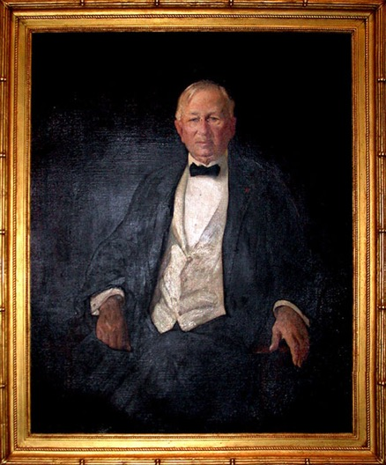
An age-old dilemma
“Half the money I spend on advertising is wasted; the trouble is I don't know which half.”
John Wanamaker—Department store pioneer

Slide 3
The purpose of marketing
“There’s really only one reason for a business to advertise and spend money on marketing: and that is to get leads/customers.”
Depending on the kind of business you have, you may think of marketing as a way to establish relationships.
If you’re involved in inbound marketing, you may think your main purpose is providing helpful information to your target audience. Though true and admirable, even the most altruistic motivations have a desired ultimate outcome: more leads.

Slide 4
Step One – Review the current year
What worked for you in 2017?
What didn’t work?
Do you know why?
What are the things you thought about trying, but didn’t?
Was it the cost involved?
The time involved?
Or did you just not know enough about it?

Slide 5
Step Two – Add one new marketing tactic
Some examples:
Update your brand identity.
Improve your sales materials.
Start a pay-per-click advertising program.
Implement E-mail campaigns or direct mail.
Whatever it is, check what others in your industry are doing and find some inspiration to try a new (to you) way to increase leads.

Slide 6
Step Three – Add metrics to your goals
Let’s say you decide to invest your 2018 budget on enhancing your brand presence by developing these materials:
Stationery and client forms
Brochures and leave-behind
Website restyle
Direct marketing campaigns
Social media posting campaign

Slide 7
Step Three – Add metrics to your goals
Decide on what it is you want to measure.
Number of new contacts, number of online orders, number of coupons redeemed, etc.
Be sure to have a way to measure these parameters.
Set a realistic goal for each activity.
Develop project milestones for each program.

Slide 8
Step Three – Add metrics to your goals
Good to know:
Realistically every new advertising activity is going to take a while to reach full effectiveness.
Everything you do should have a cumulative effect that will be visible over time.
That being said, if you’ve given it your best shot, and a certain type of advertising just isn’t showing results, check with an expert to make sure you’re doing it right.
If you are, and it’s still not working, shift your resources and energy to a tactic that shows more potential.

Slide 9
Step Four – Don’t set it and forget it
Monitor, evaluate, and refine each program as needed.
You’re busy running your business, and that’s your primary activity, but make time to regularly check on your advertising and marketing programs so you can adjust them throughout the year.
Maintain a chart of your activities with key indicators to use as a reference for your year-end review.
Make sure each program it’s on track and not falling behind schedule.

Slide 10
Step Five – Hire a professional
Whether it’s updating your brand identity, increasing your direct mail advertising, or setting up a business Facebook page, it is money well spent to hire professional help rather than trying to save money by doing it all yourself or trusting your marketing management to unqualified employees, friends, or relatives.
But even if you hire a consultant to help you with your marketing, everything will be more effective the more engaged YOU are in the process.
Be available for your creative consultant, web designer, your PPC campaign manager or social media manager on a regular basis.
Make sure your vision and brand personality are represented consistently.
Every dollar you spend will provide more value if you make yourself accessible to the people you pay to help your brand succeed.

Slide 11
Some quick examples
Branding with Ethos

Slide 12
Branding – Logo
ANEW
Logo design

Slide 13
Branding – Stationery
Basic stationery package

Slide 14
Branding – Forms Certificates
ANEW
Awards and certificates

Slide 15
Branding – Presentations
Presentation materials, press kit, Initiative logo

Slide 16
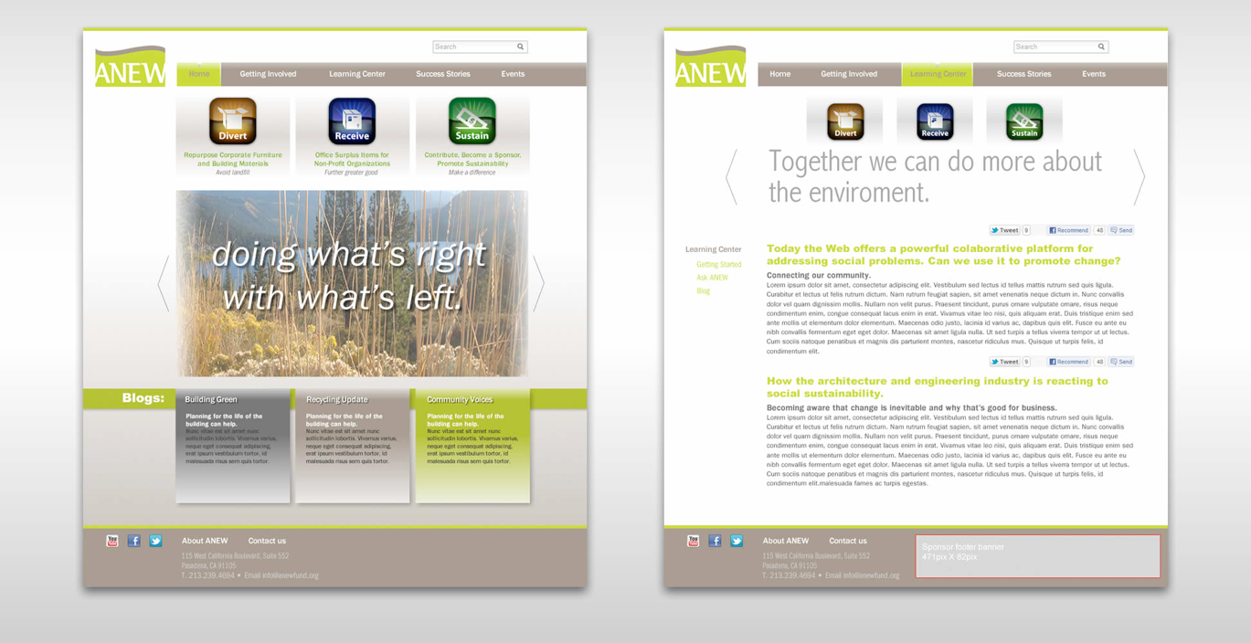
Branding – Website

Slide 17
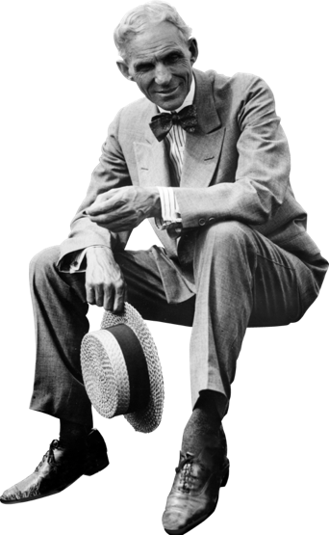
Parting thought
“A man who stops advertising to save money is like a man who stops the clock to save time.”
Henry Ford—Industrialist

Slide 18
Thank You.
This presentation is available for download at
portfolio.ethosfactory.com/bni-presentations

Slide 19
Ethos Factory – A network of ideas
portfolio.ethosfactory.com

