Slide 1
Finding your ethos
Image is EVERYTHING:

Slide 2
Our name is our purpose
e•thos (ēˈthŏs)
n. The disposition, character, or fundamental values peculiar to a specific person, people, culture, or movement:
"They cultivated a subversive alternative ethos” (Anthony Burgess- author of The Clockwork Orange, 1962)

Slide 3
Our name is our purpose
fac•to•ry (făkˈtə-rē)
n. A building or group of buildings in which goods are manufactured; a plant:
“Our brain is the factory of the emotions” (Don Miguel Ruiz- author of The Four Agreements, 1997)

Slide 4
Our Ethos is simple
Be able to inspire
Try new things
Ask lots of questions
Be passionate
Be curious
Exceed everyone’s expectations, especially our own
Know how to fix things
Always take the stairs

Slide 5
Things we like to call work
Branding
Logo design
Brochures and collateral
Retail concepts
Fine Art graphic design

Slide 6
Branding – It’s all about continuity
To be successful a brand has to maintain its character across all mediums, from a Homepage to the office lobby.
Digital platforms have few limitations when it comes to visual rendering, but most brands are still tied to the real world, be mindful of this or you will have problems.
Successful branding appears effortless.

Slide 7
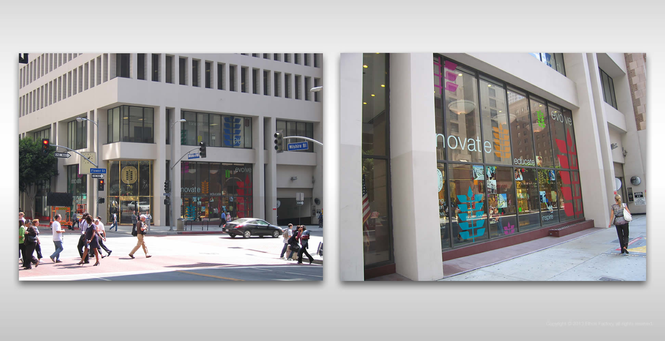
Branding – Corporate
LACCD
Los Angeles city college district - Headquarters

Slide 8
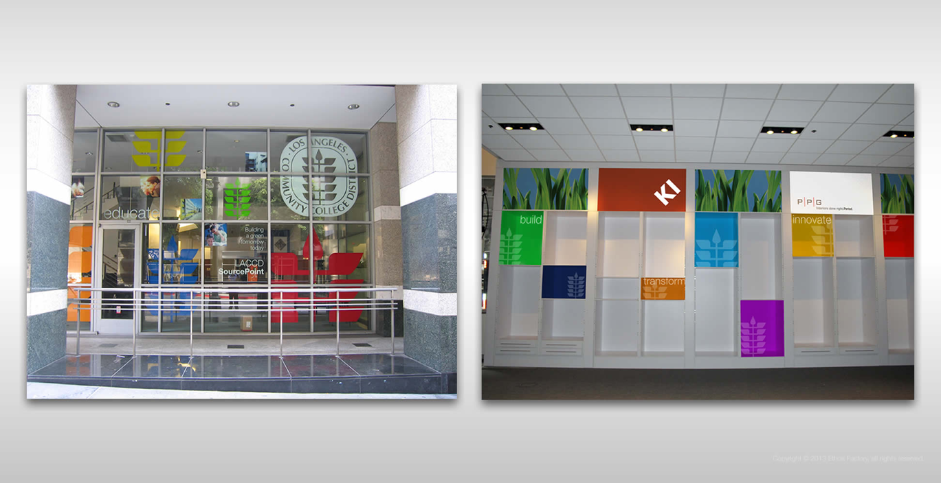
Branding – Corporate
Los Angeles City College District - Showroom

Slide 9
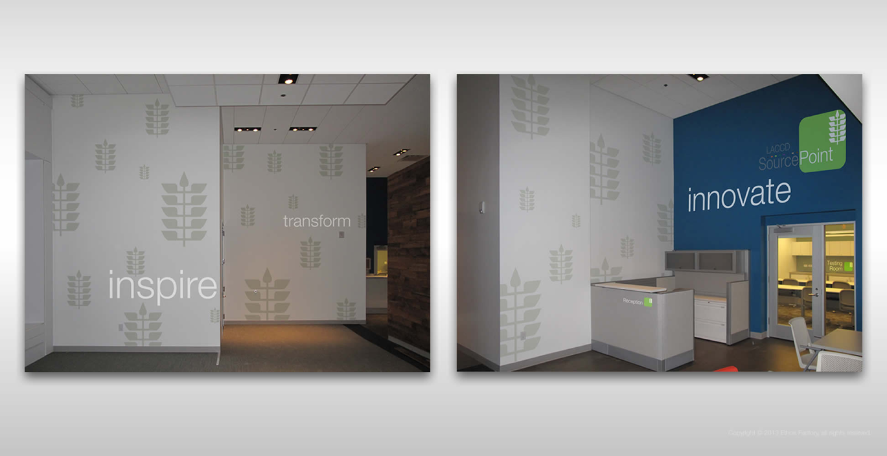
Branding – Corporate
Los Angeles City College District - Showroom

Slide 10
Branding – Corporate
Los Angeles City College District - Recycling program, district-wide

Slide 11
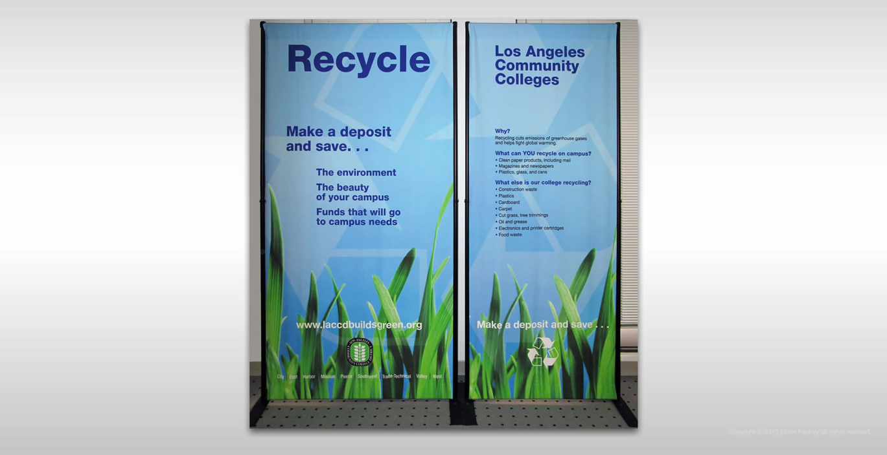
Branding – Corporate
Los Angeles City College District - Recycling program, district-wide

Slide 12
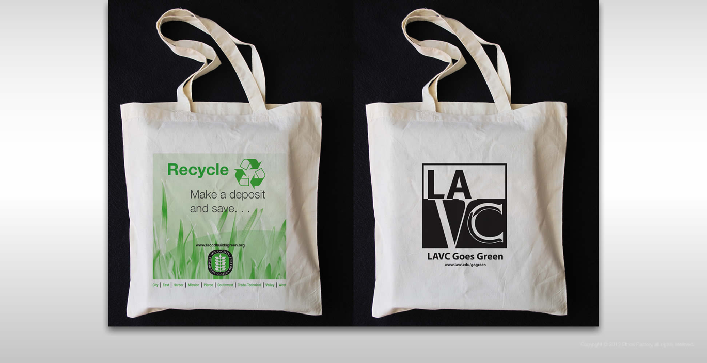
Branding – Corporate
Los Angeles City College District - Recycling program, district-wide

Slide 13
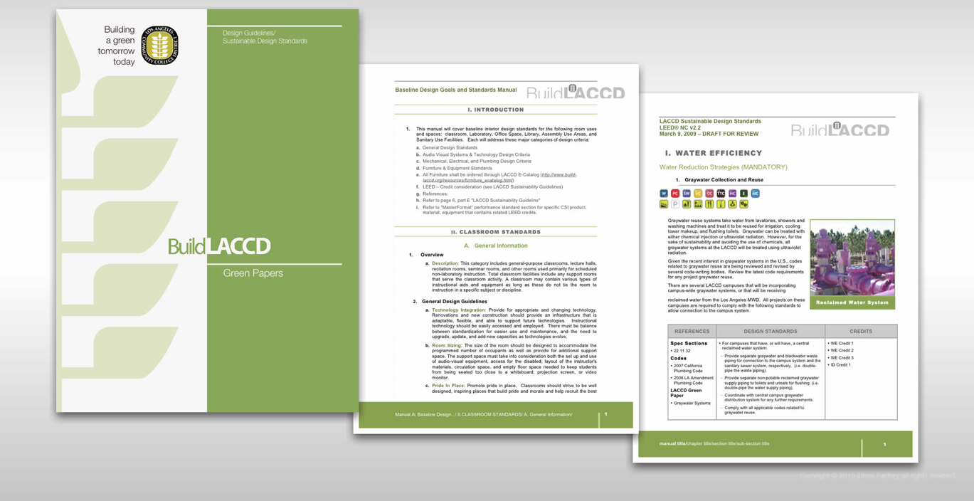
Branding – Corporate
Los Angeles City College District – Manuals and reference books

Slide 14
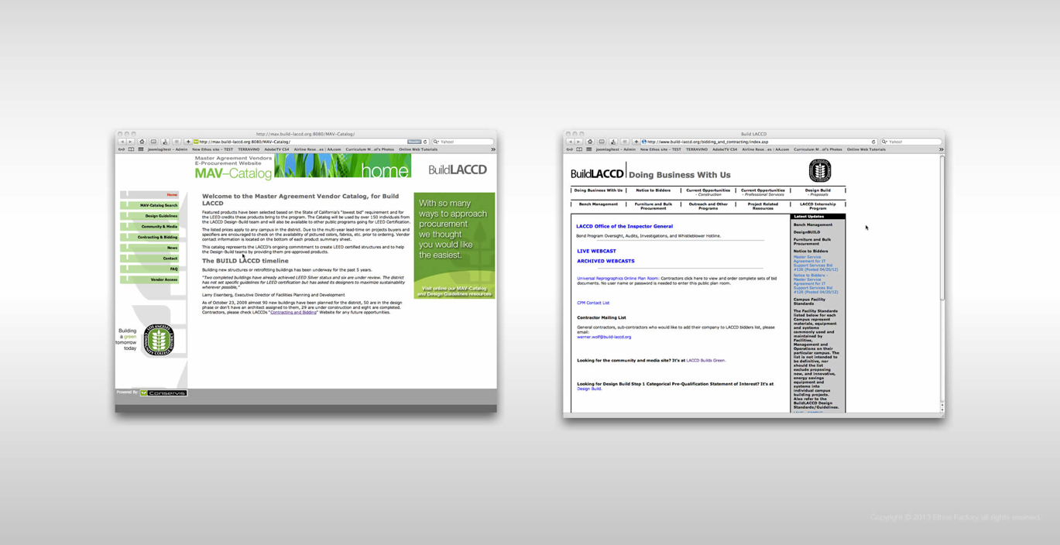
Branding – Corporate
Los Angeles City College District – Manuals and reference Websites

Slide 15
Branding – Consumer
LACCD
Logo study – Mr. Bright concept

Slide 16
Branding – Consumer
LACCD
Logo study – Mr. Bright concept, moods range

Slide 17
Branding – Consumer
LACCD
PowerPoint– Outreach presentations

Slide 18
Branding – Consumer
LACCD
Lobby posters – Benefits education

Slide 19
Branding – Consumer
LACCD
In-ofice posters – Employee relations, promotions

Slide 20
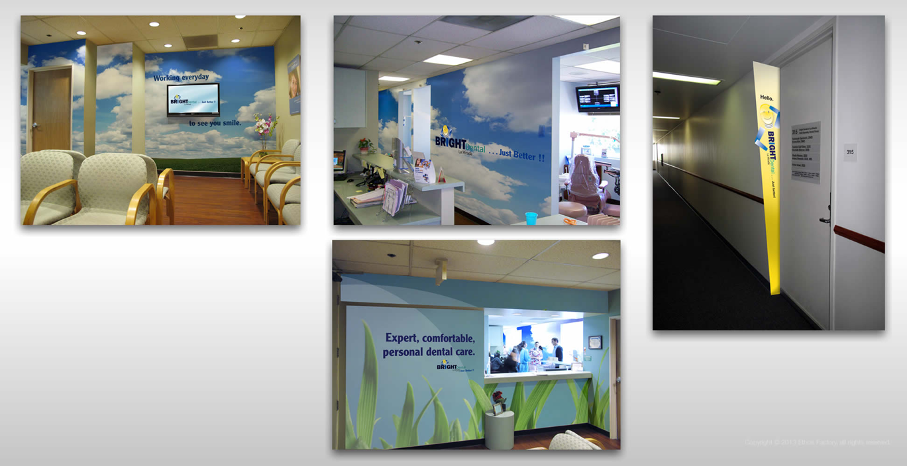
Branding – Consumer
In-office branding – Proposed concepts

Slide 21
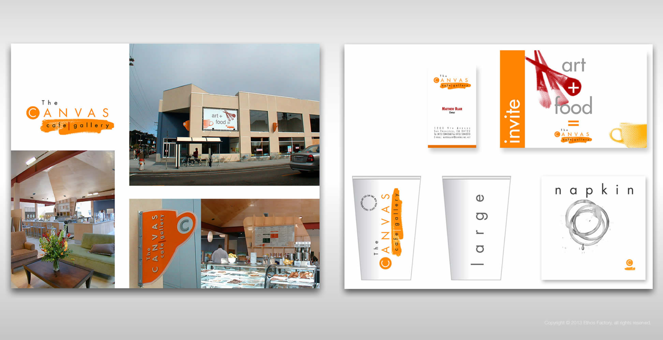
Branding – Consumer
Art Gallery/Café – Retail concept store

Slide 22
Branding – Non-profit
ANEW
Furniture and fixtures repurposing/recycling– Logo concept

Slide 23
Branding – Non-profit
Furniture and fixtures repurposing/recycling– Stationery package

Slide 24
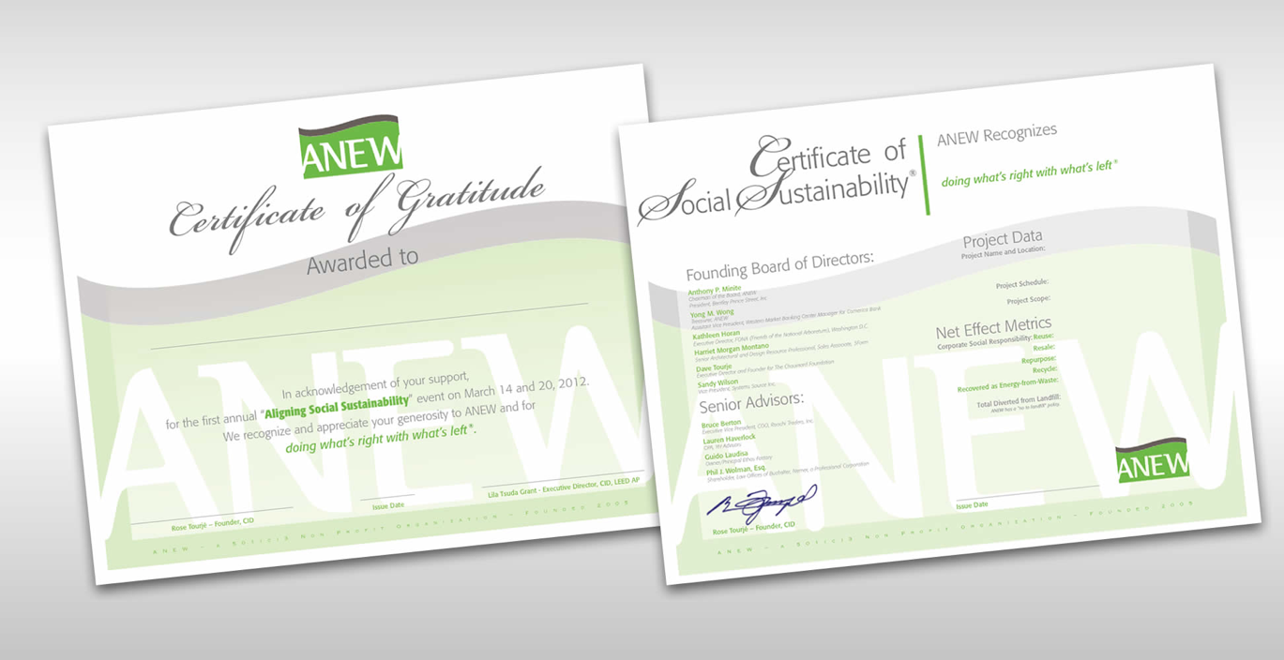
Branding – Non-profit
ANEW
Furniture and fixtures repurposing/recycling– Awards and certificates

Slide 25
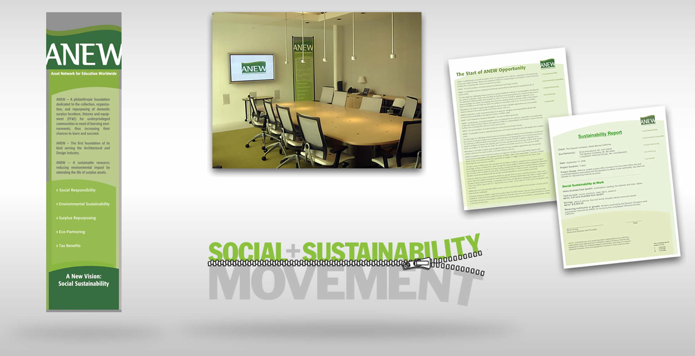
Branding – Non-profit
Furniture and fixtures repurposing/recycling– Presentation materials, press kit, Initiative logo

Slide 26
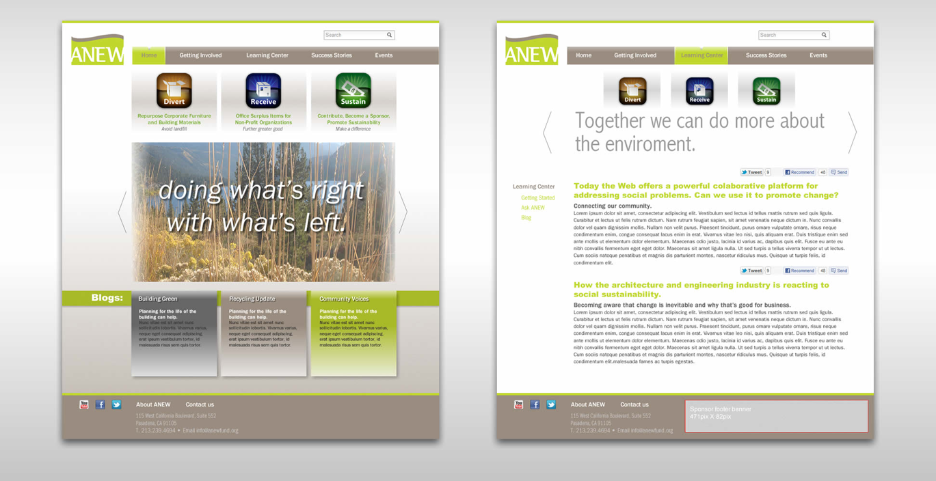
Branding – Non-profit
Furniture and fixtures repurposing/recycling– Website

Slide 27
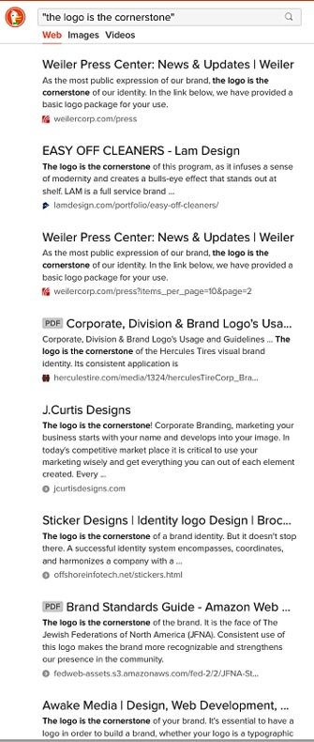
Logos – The flag you take to battle
The logo is the cornerstone of every successful visual identity, but don’t take our word for it.
Good to know: From an implementation standpoint a bad logo is as expensive as a good one, once your understand that it will cost the same (if not more) to have it reproduced throughout your corporate identity and communications.

Slide 28
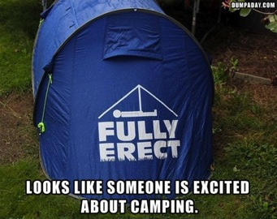
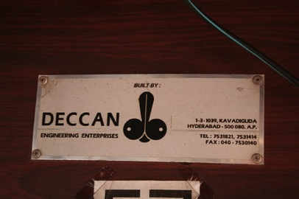
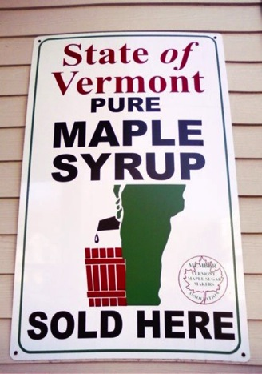
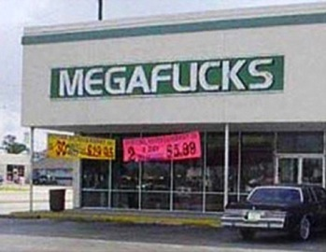
Logos – Unintended consequences

Slide 29
Logos – With ethos
Solar Power Generators

Slide 30
Logos – With ethos
Law Offices

Slide 31
Logos – With ethos
Private Wealth Management

Slide 32
Logos – With ethos
Rural Bed and Breafast

Slide 33
Logos – With ethos
Real Estate Agency

Slide 34
Fine Art Graphics – Visual pleasures
As devices take control over our world the tactile pleasure of print media is disappearing.
Good to know: Digital printing allows for countless opportunities for any brand that wants to seduce its viewer through a rich visual experience, at a fraction of the price of traditional lithography.

Slide 35
Coffee table books – Visual delights
Bijan Beverly Hills – Car collection

Slide 36
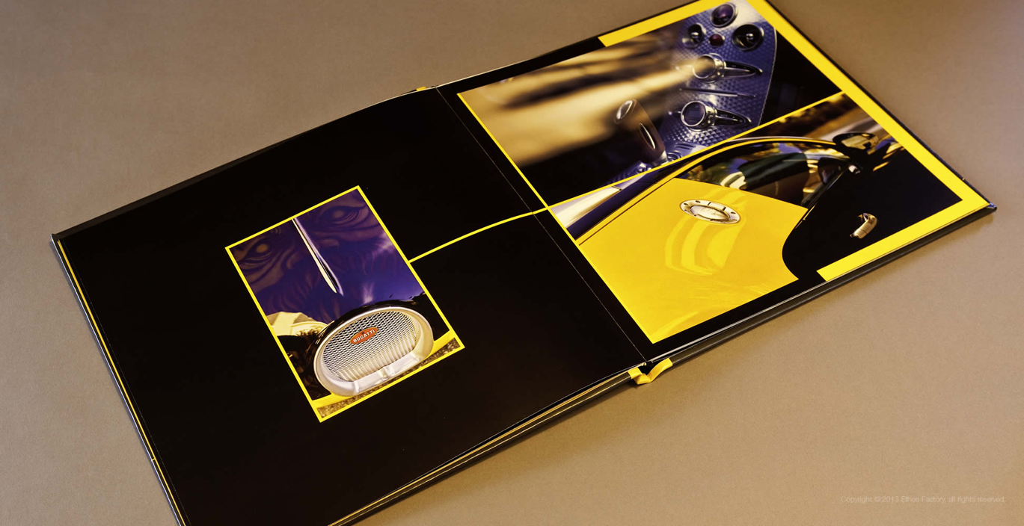
Coffee table books – Visual delights
Bijan Beverly Hills – Car collection

Slide 37
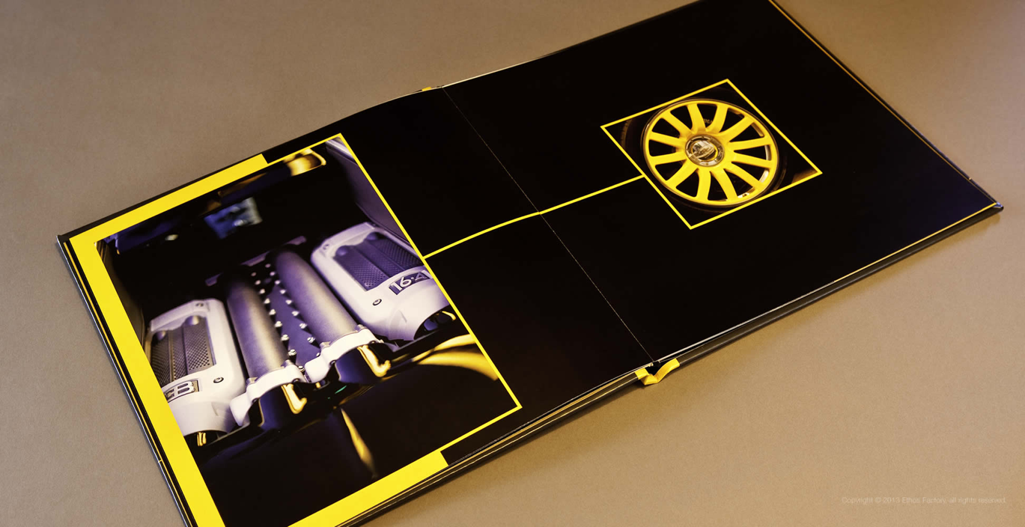
Coffee table books – Visual delights
Bijan Beverly Hills – Car collection

Slide 38
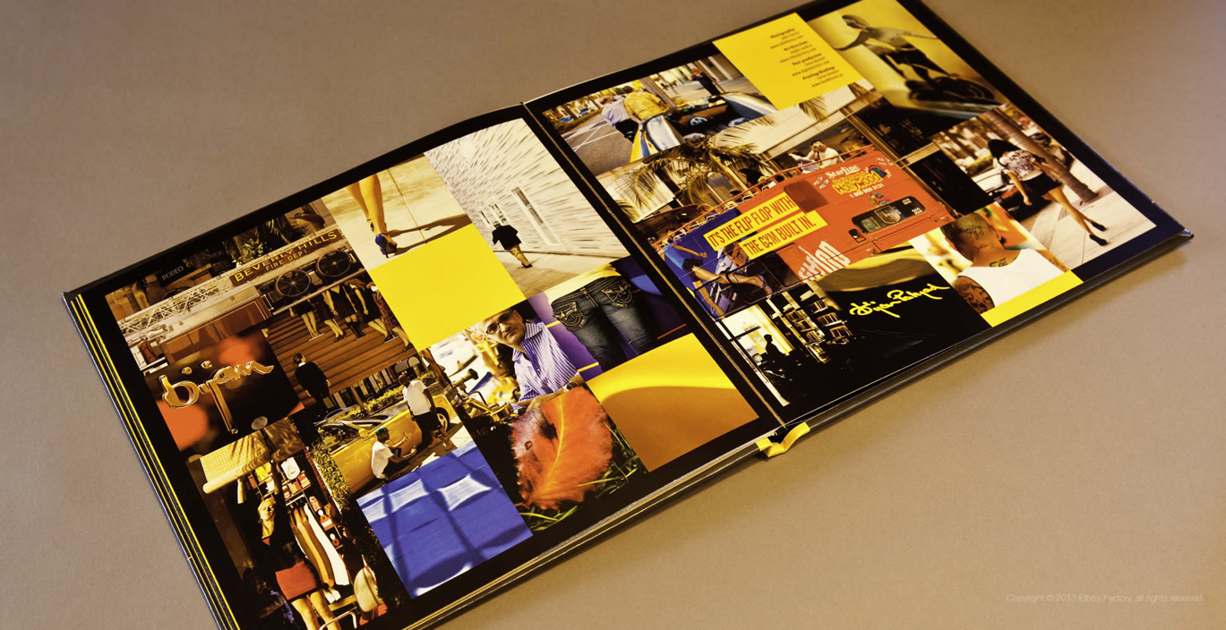
Coffee table books – Visual delights
Bijan Beverly Hills – Car collection

Slide 39
Coffee table books – Visual delights
John Livzey Photography– Architecture and Engineering Portfolio

Slide 40
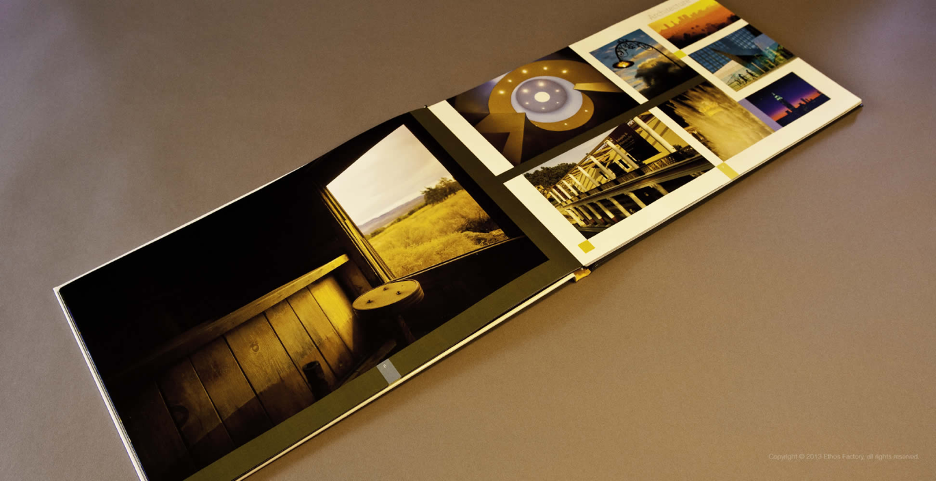
Coffee table books – Visual delights
John Livzey Photography– Architecture and Engineering Portfolio

Slide 41
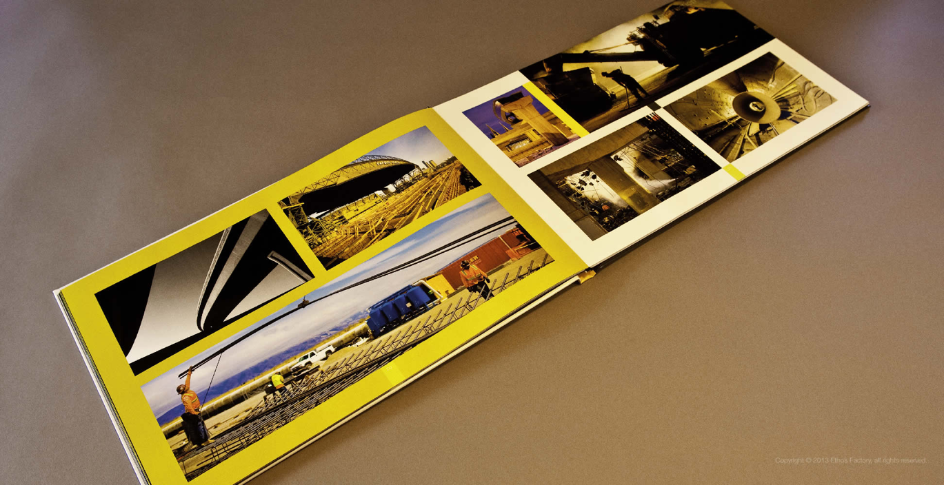
Coffee table books – Visual delights
John Livzey Photography– Architecture and Engineering Portfolio

Slide 42
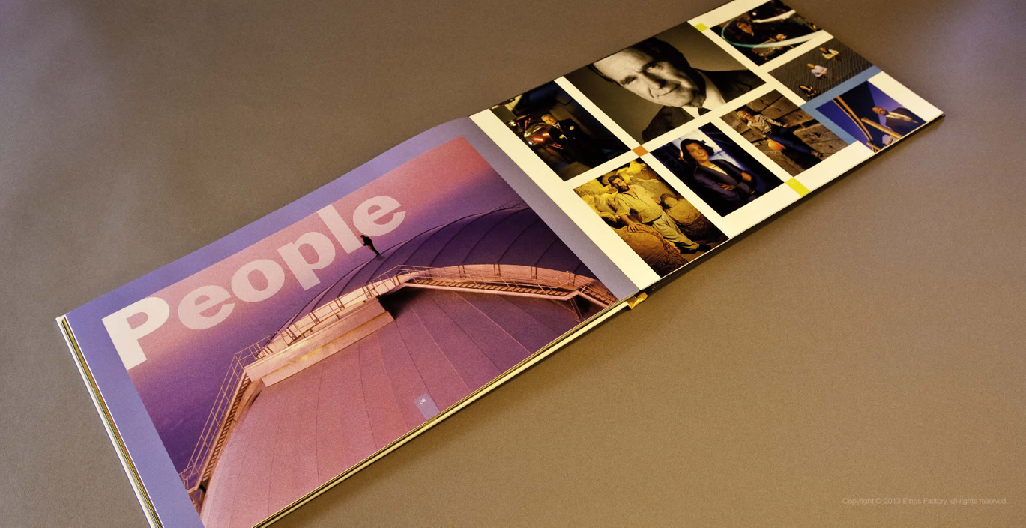
Coffee table books – Visual delights
John Livzey Photography– Architecture and Engineering Portfolio

Slide 43
Parting thought
“Owning a graphic design software makes you a Graphic Designer the same way that owning a tennis racket makes you Roger Federer.”
(Guido Laudisa- author of Finding Your Ethos, 2016)

Slide 44
Thank You.
This presentation is available for download at
www.ethosfactory.com/portfolio/bni-presentation

Slide 45
www.ethosfactory.com/portfolio

